Slide 1
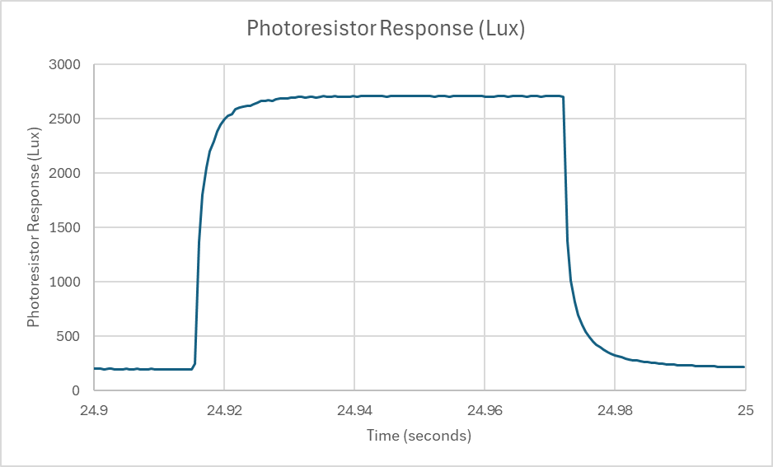
Steps to obtain tau by curve fit
1. Make a scatter plot of the photoresistor response data with columns A and B in the data file. Change the x-axis so that only one cycle of the photoresistor response for the LED on and the LED off as shown. Later we will work on improving the quality of this plot for placing it in publications and homework reports.
LED
OFF
LED
ON

Slide 2
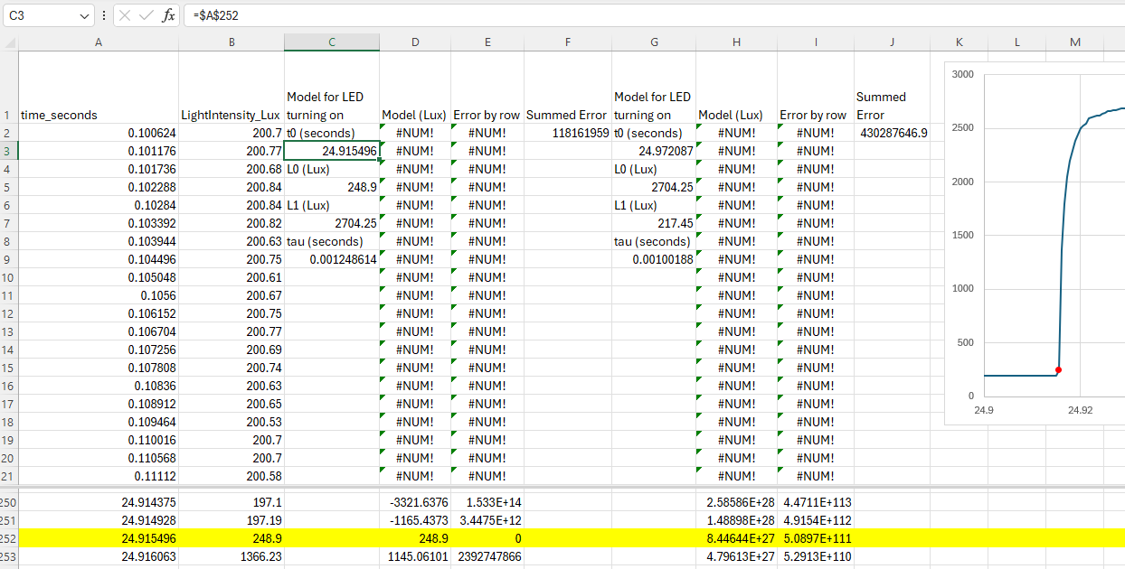
Columns A and B are the measurement data. We’ll make Columns C-J for the model to obtain tau, the photoresistor response time.
2. Create the column headings in column C as in the example below.
3. Hover over the point in the graph where the Lux value cleanly starts to go up, indicated by the red dot in the red box on the right and write down the time.
4. Find the row for this time, below in yellow as row 252 for this example.
5. Put the start time t₀ in cell C3, in this example as =$A$252. Put the corresponding lux value into cell C5 as =$B$252. $ signs tell Excel to always use the column and/or row when the formulas get copied to another place .
t₀,L₀

Slide 3
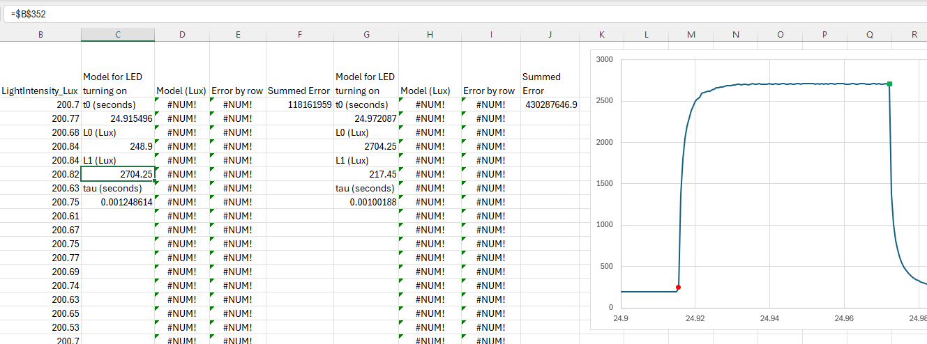
6. Hover over the point in the graph where the Lux value reaches a level peak, indicated by the green dot in the green box on the right and write down the time.
7. Find the row for this time, below in yellow as row 352 for this example.
8. Put the corresponding lux value into cell C5 as =$B$352 for this example (yours may be a different number).
9. Enter a value for tau (seconds) below, in this example, 0.001248614.
NOTE: The cell with #NUM! are not a problem since the Model (Lux) values are only relevant to the problem at times near the pulse shown after the time of the red dot.
L₁

Slide 4
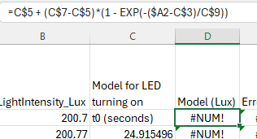
Add the model equation to column D.
10. Put this equation for the model into cell D2.
11. Propagate the model down by clicking on the little green square on the bottom right of cell D2.

Slide 5
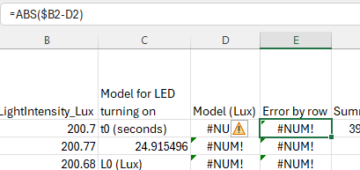
Add the Error by row to column E.
12. Enter this equation for the Error by Row into cell E2. This is the absolute value of the difference between the model and the measurement.
13. Propagate the error down by clicking on the little green square on the bottom right of cell E2.

Slide 6
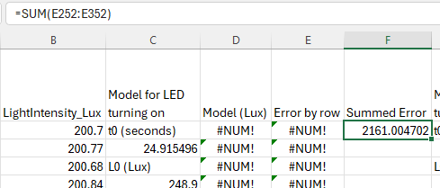
Summed Error goes into cell F2.
14. Enter this equation for the Error by Row into cell E2. This is the absolute value of the difference between the model and the measurement.
Note that your cell numbers for the beginning cell (E252) needs to be the row you used for t₀ and ending cell (E352) needs to be the row used for L₁.

Slide 7
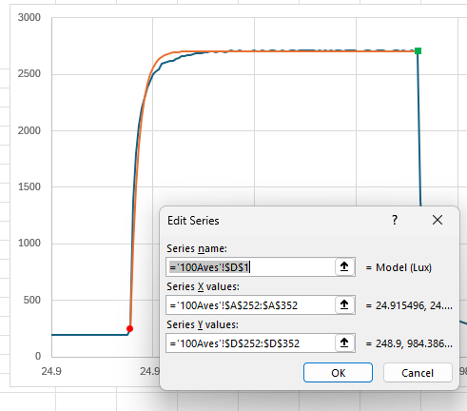
Add the model curve to the graph
15. Right click in the middle of the graph and choose “Select Data”. Then click on “Add” to bring up the menu below.
In this example, ‘100Aves’ is the name of the sheet, and the range of values 252 to 352 are for this example, yours may be different.
After clicking on ‘OK’ a curve like the orange one should show up. We only want to plot the model where it is applicable.
Later we will make the graph more acceptable for publication.

Slide 8
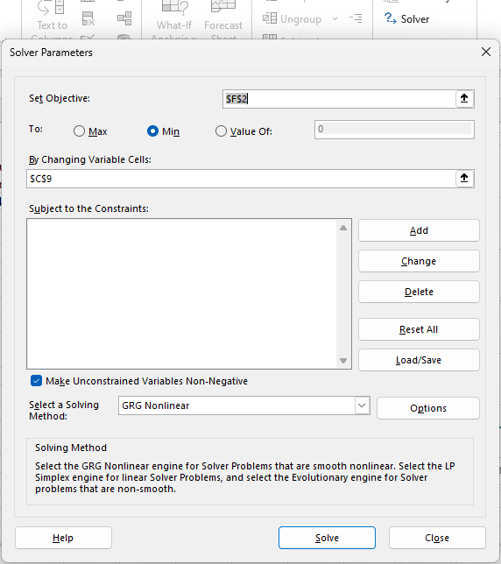
Find the value of tau that minimizes the summed error.
16. Under the data tab, on the far right, find the ‘Solver’ and click on it to bring up this dialogue. The objective is $F$2, which is the summed error. We want it to be a minimum value, and minimize it by changing variable cells: $C$9, which is the value of tau. After clicking on ‘Solve’ a new solution for tau should be in the cell $C$9 and the dialogue box should say ‘found a solution’. Keep the new value. That’s the optimal value of tau that makes the model best the measurements.
If your computer does not have the Solver installed, here’s how you can do it. The sequence is File:Options:Add-ins:Manage Excel Add-ins Go...:Click on Solver Add-in:OK. Each step is separated by a colon.

Slide 9
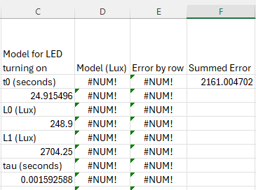
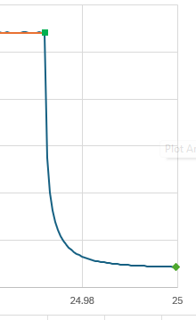
Do the curve fit for the photoresistor Lux values going down after the LED is off
17. Select these cells and copy them into the clipboard (Ctrl C for Windows). Right click on cell G1 and choose ‘Paste Special’. Then choose “formulas” (I think it is the second in the list. Propagate the “Model (Lux)” and “Error by row” by clicking on Then find new values for t₀, L₀, and L₁ the same way we did for the LED on part earlier. Select cell H9 and then double click the little green square in the bottom right of that cell to propagate the equation down. Then click on cell I9 and double click the little green square to propagate it down also. Scroll down to make sure it propagated the calculations to the bottom. If not, select the last row with numbers in it to propagate further. Keep doing that until the numbers in columns H and I reach to the lowest numbers in columns A and B.
t₀, L₀
L₁

Slide 10
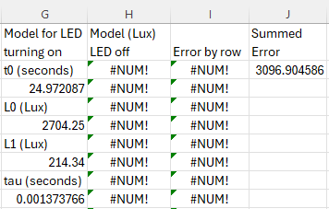
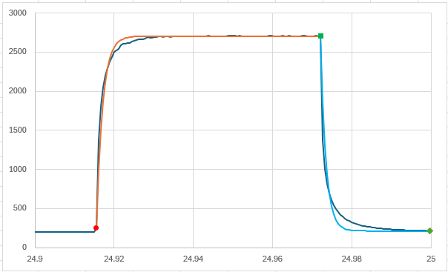
Add the graph of the model for LED Off as shown below
18. After using the solver again (as earlier) the ‘Summed Error’ should be a minimum for the value of tau shown. This is the response time for photoresistor after the LED is turned off.

Slide 11
Create publication quality graphs
Large dark fonts that are visible from 10 feet away from your monitor.
Color choices and line types (solid or dashed) that are easy to identify.
Frame around the entire plot.
Tick marks on the plot, usually facing inside.
Note that right clicking on chart elements, like axis numbers, the interior of the plot, the exterior of the plot, the data curves, etc, allow you to change their properties.
This is a guide for the style I find most effective, you may find other styles that work better for your perspective or problems at hand.

Slide 12
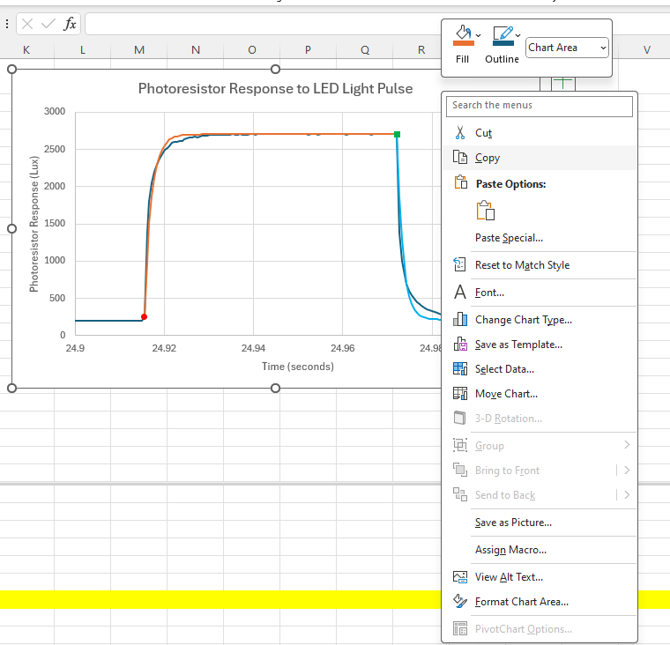
Make a Publication Quality Graph With the Following Steps
1. Right click here to bring up menu. 2. Click on Copy.

Slide 13
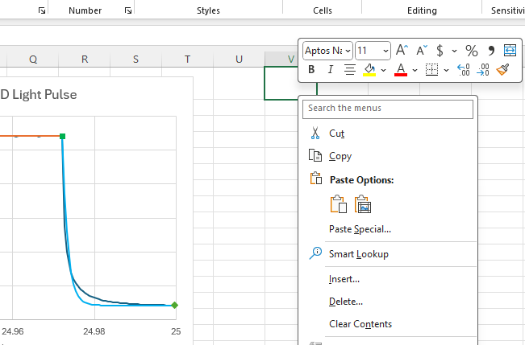
Make a copy of the graph
1. Click on cell V1 (or equivalent in your spreadsheet.
2. Right click on V1 to bring up the menu below.
3. Click on the red box below Paste Options:
A copy of the graph should appear.
xxz

Slide 14
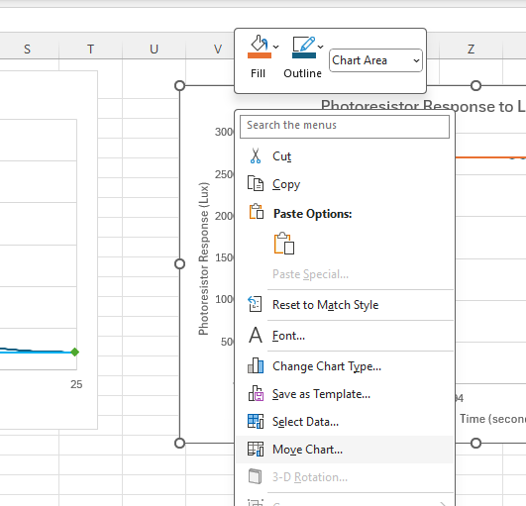
Make a copy of the graph
1. Right click here on the graph in an empty place above the graph and below the top.
2. Click on Move Chart…

Slide 15
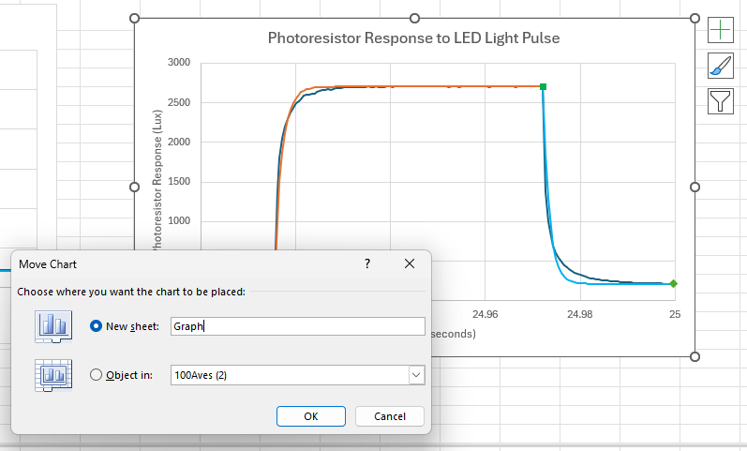
Move the graph to a new sheet
1. Click on New sheet:
2. Use a new name for the new sheet, example below is Graph.
3. The graph should be in its new sheet.

Slide 16
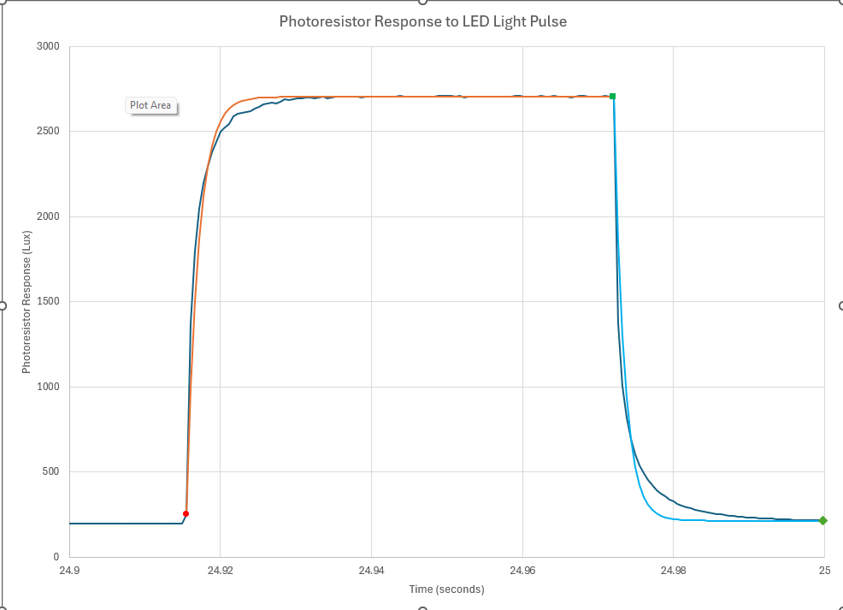
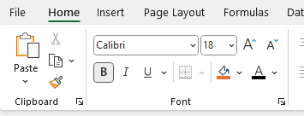
Here’s the graph in its own sheet. Change the default font size and all.
1. Click here on the graph in an empty place above the graph and below the top to select the entire graph.
2. Click the options on the right. The result is on the next page.

Slide 17
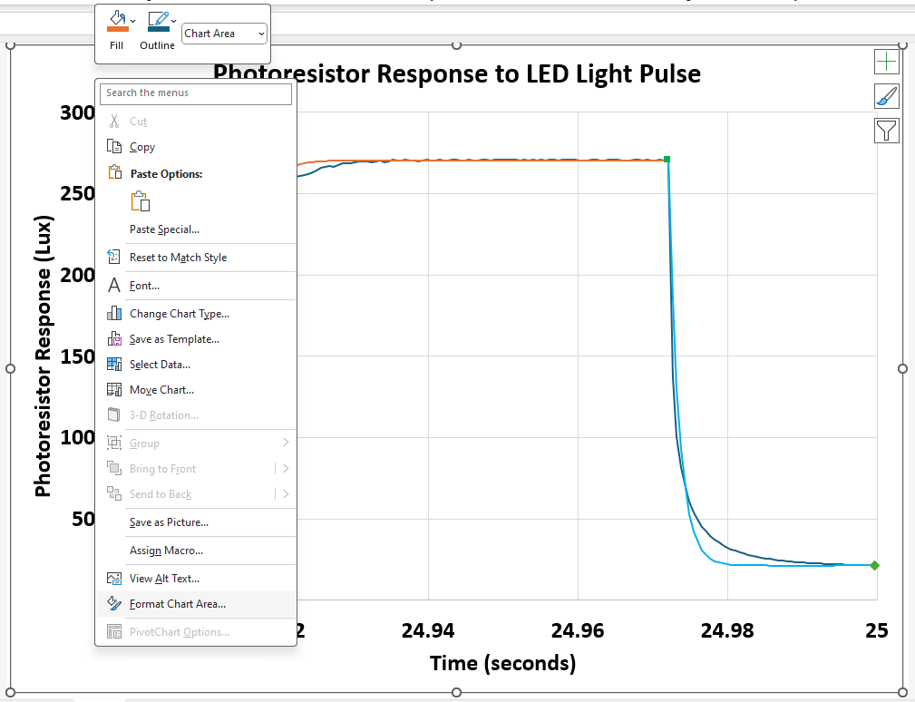
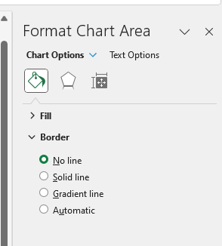
Get rid of the border around the outside.
1. Right click here on the graph in an empty place above the graph and below the top to select the entire graph.
2. Click the options on the right. The result is on the next slide.

Slide 18
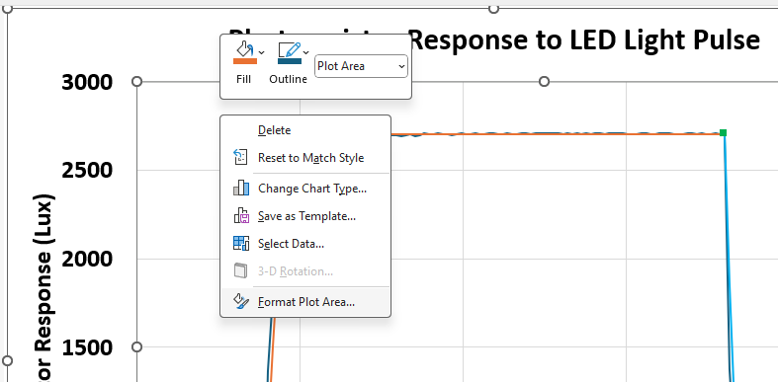
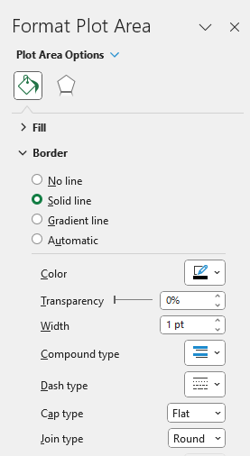
Add a border around the plot itself
1. Right click here in the graph area.
2. Click the options on the right. The result is on the next slide.

Slide 19
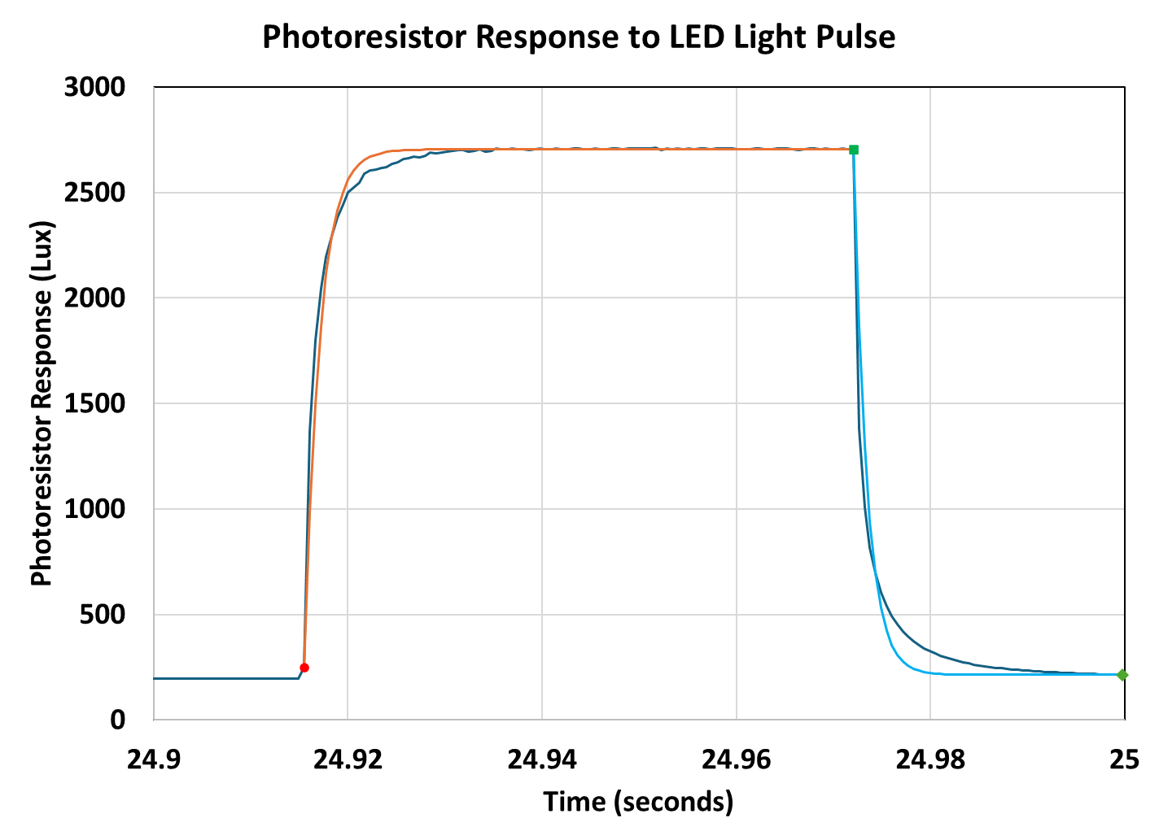
Get rid of the grid lines
1. Click on a horizontal grid line and delete.
2. Do the same for the vertical grid lines (delete them).

Slide 20
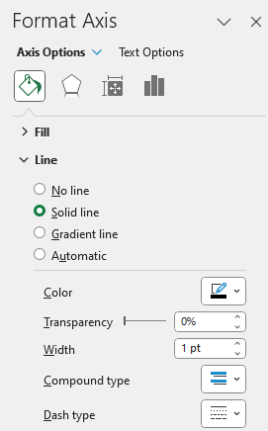
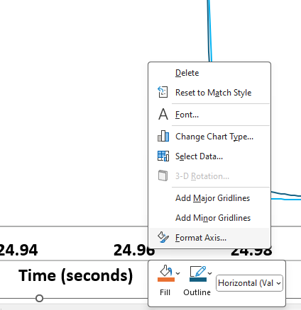
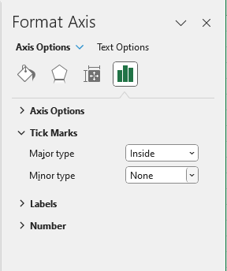
Make the axes 1 pt wide, black, and add tickmarks
1. Right click on one of the numbers on the horizontal axis to bring up the dialogue box.
2. Select Format Axis…
3. Make the settings shown for the axis line color and properties.
4. Then go to the tool on the right (3rd screen shot on this page.)
5. Tick Marks:Major type:Inside.
6. Do the same steps 1-5 for the vertical axis.

Slide 21
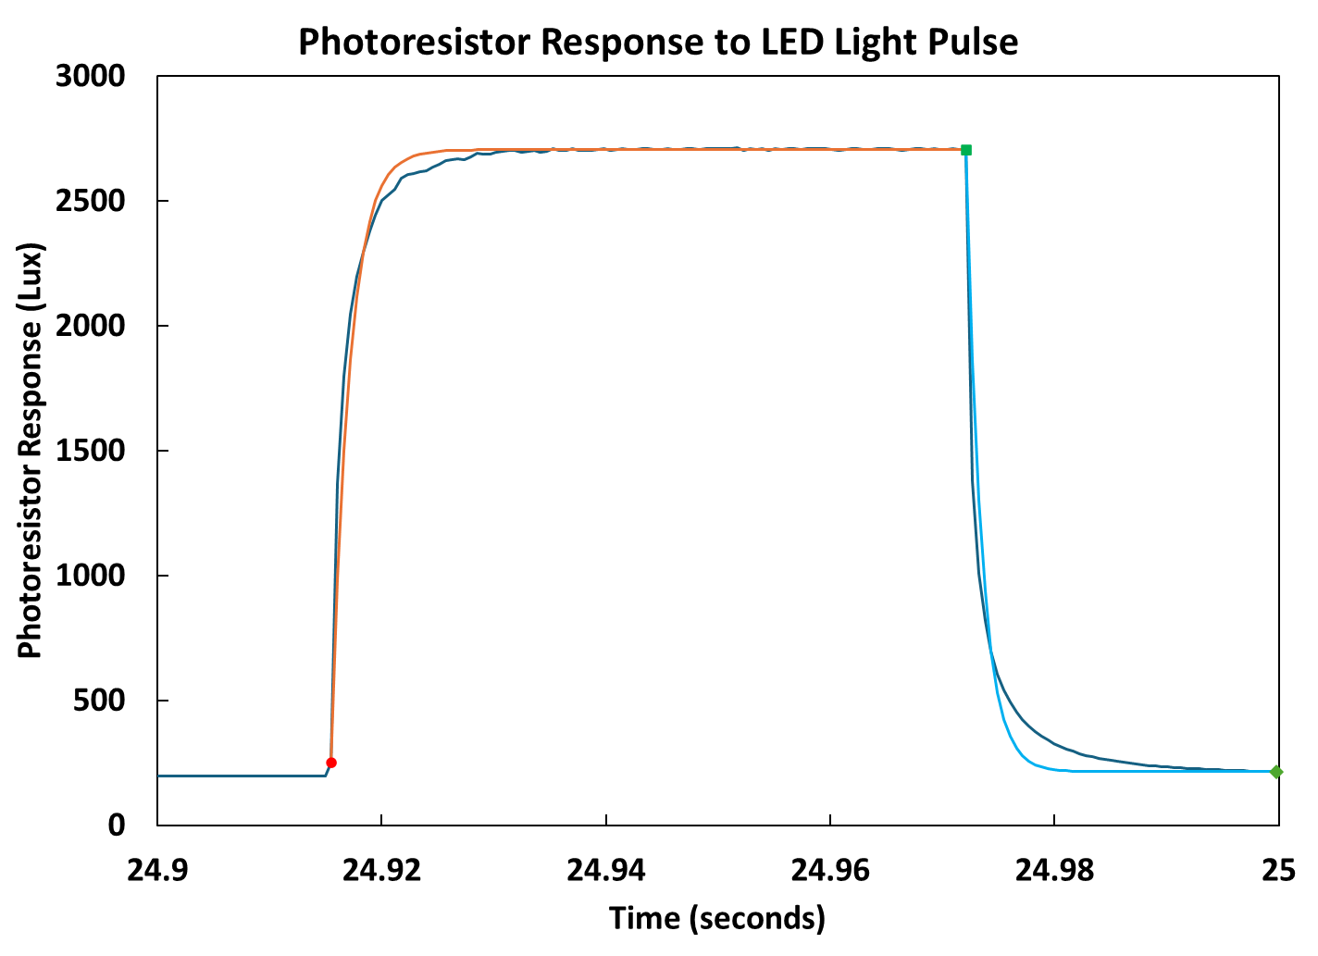
Adjust the plot to fill the entire canvas
1. Click on each axis in the middle and use the round handle to move the axis close to its closest ‘wall’, to use all of the graph space.

Slide 22
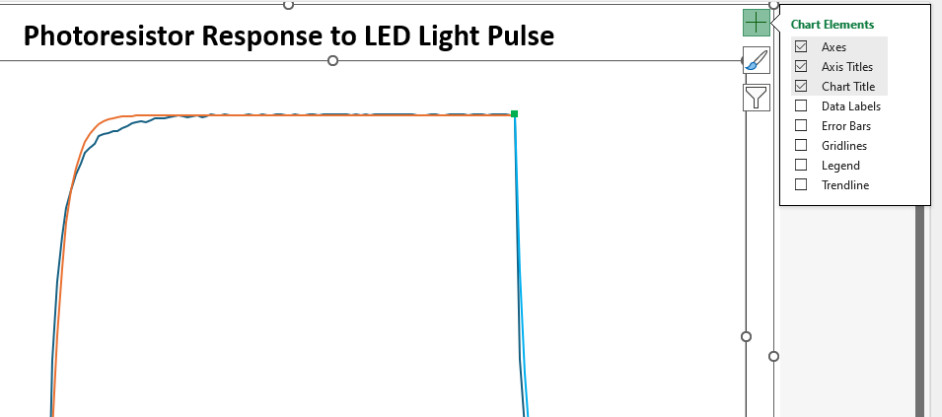
Adjust the plot to fill the entire canvas
1. Click in the middle of the chart to bring up the large green + in the upper right corner.
2. Click on legend to add it, and move it to a good spot.

Slide 23
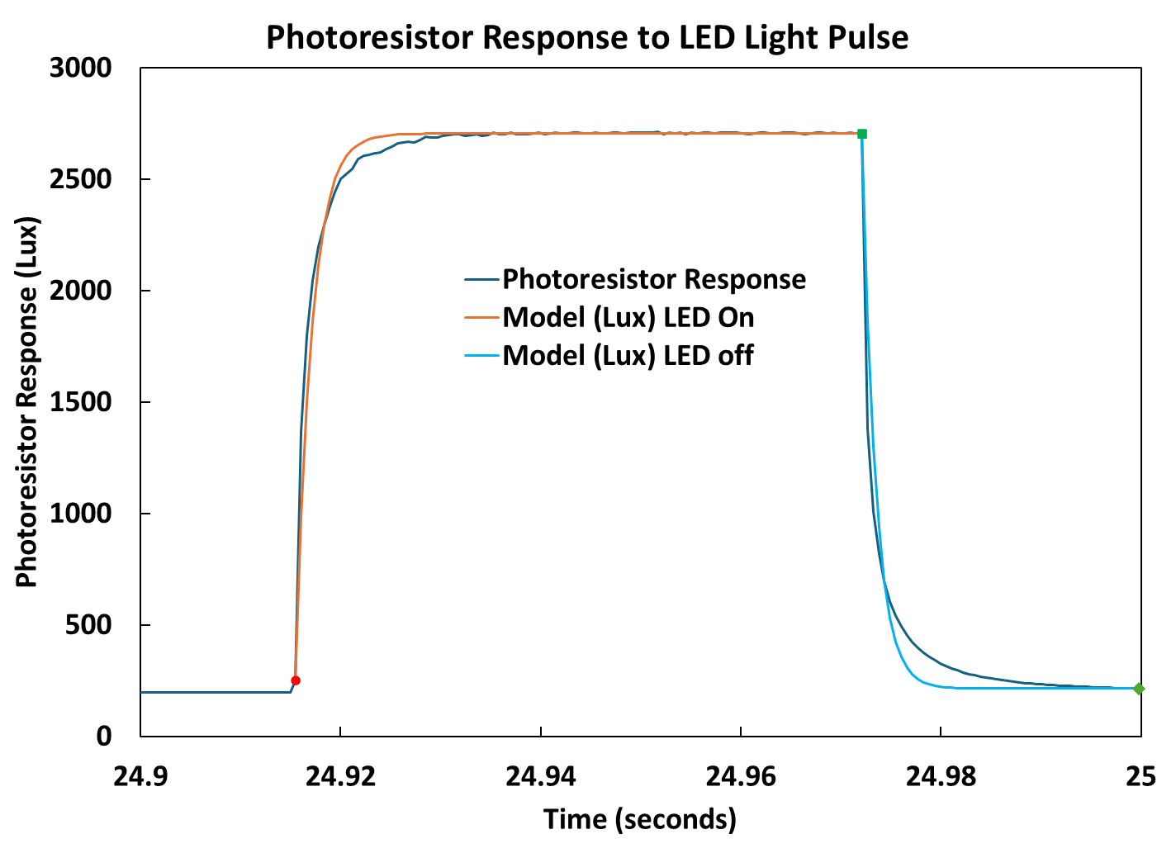
You made it! Congratulations!!

Slide 24
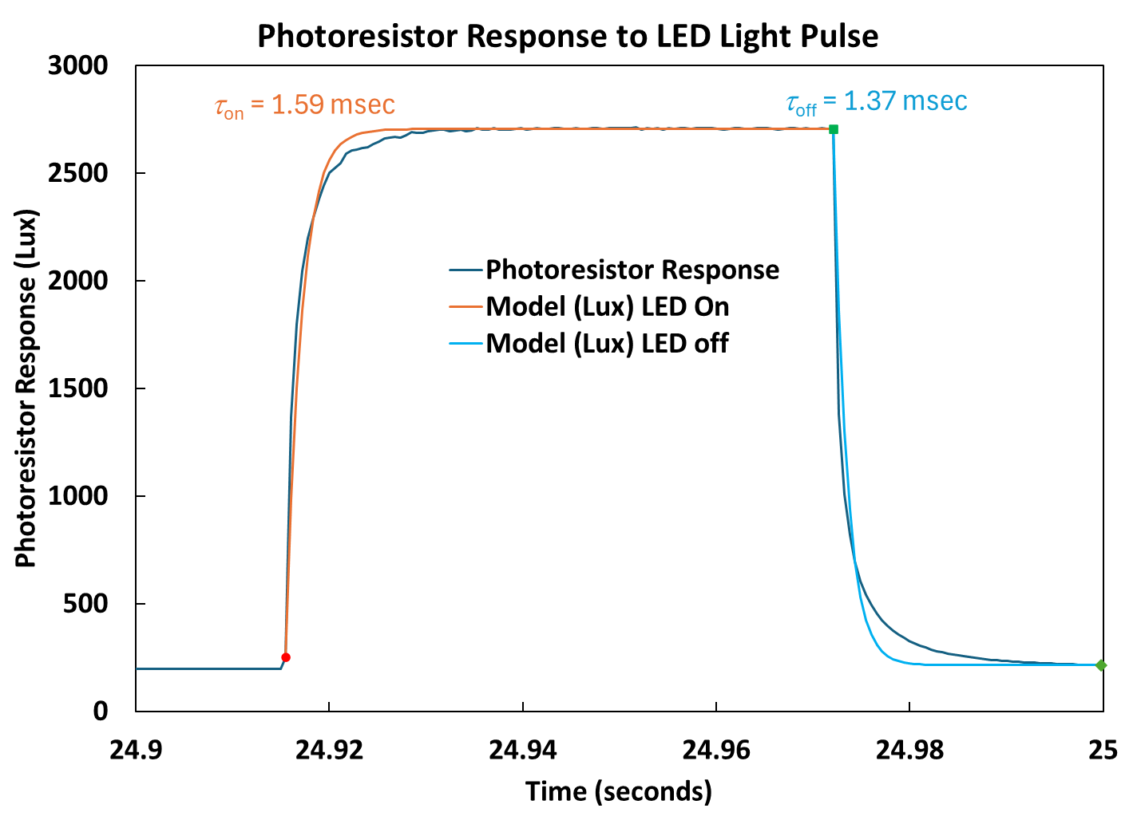
This version has the response time for the LED on and off included:
Sequence is Insert:Text Box then drag a box where the text goes.

